Slide 1
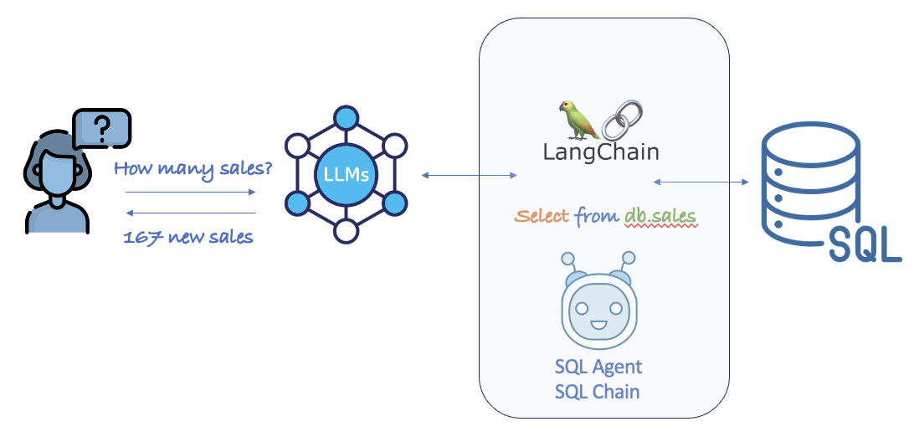
AI over BI – Talk to your data
Problem Statement : There is no easy way for users to get information they are interested from SQL databases. They are dependent on reports to be published by support teams.
Solution : Leverage the power of Gen AI(Chat GPT in this case) to create a chat bot using which users can query databases.
Technologies used : Python, Chat GPT, Gradio (Front End)

